Slide 1
Universal Design for Learning
ETEC 562
Texas A&M University- Commerce
Instructor Dr. Mary Dziorny
Lauren Finnerty, Tameka Giles and Shannon Betz-Decker

Slide 2

Summary
Universal Design for Learning, or UDL, has roots in both architecture and cognitive neuroscience. Ronald Mace had the idea to create physical environments that from the start would meet the diverse needs of all individuals. Meaning, we could provide a more functional environment or product for everyone, not just the disabled.(4) UDL is a set of principles for curriculum development that give all individuals equal opportunities to learn. It provides a blueprint for creating instructional goals, methods, materials, and assessments that work for everyone--not a single, one-size-fits-all solution but rather flexible approaches that can be customized and adjusted for individual needs.(1)

Slide 3
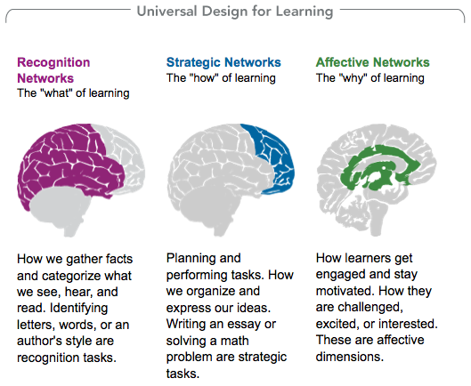
Summary
  UDL is a neuroscience based framework that is based upon 3 main principals.
  So our learning styles are basically like snowflakes and UDL provides a framework to plan lessons in a way that all learners are reached by targeting those in the “margins” rather than just the average.
  One example they used in a video online referred to captions that are used on TV. “Captions can be useful for deaf people, people trying to learn a new language, people in the gym, spouses who watch TV at different hours of the night.”(1)

Slide 4
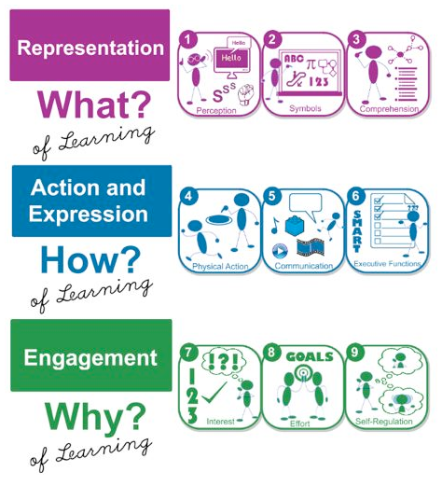
Key points
What is Universal Design for Learning (or UDL)?
  “UDL is a set of principles for curriculum development that give all individuals equal opportunities to learn.” (1)
Who is UDL for?
  “UDL can assist anyone who plans lessons or develops curriculum to reduce barriers, as well as optimize levels of challenge and support, to meet the needs of all learners from the start.” (2)
What are the three primary brain networks according to UDL?
  Recognition Networks aka the "what" of learning
  Strategic Networks aka the "how" of learning
  Affective Networks aka the "why" of learning (2)

Slide 5
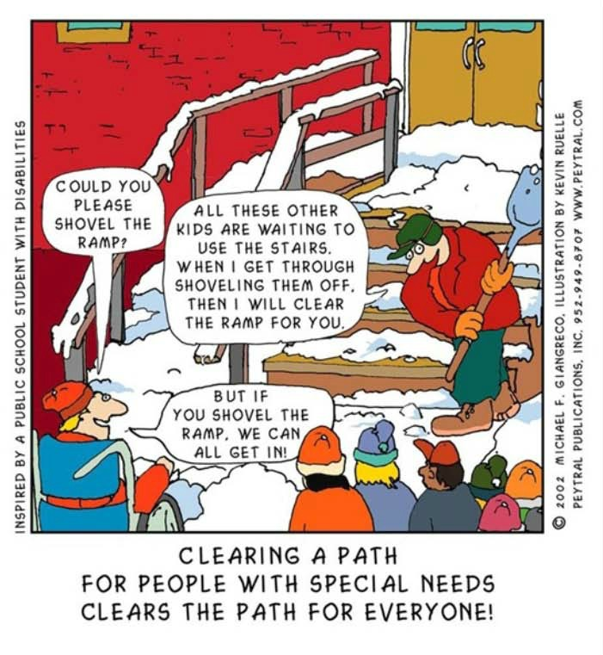
Key Points
  How does the UDL address learning?
    Through the UDL Guidelines.
      Provide multiple means of Representation such as media.(3)
      Provide multiple means of Action and Expression, such as options for them to express what they know and provide models, feedback and support.(3)
      Provide multiple means of engagement such as choices to fuel learning, goal setting and a love of learning. (3)
  UDL and Technology:
      Computers on great for this design because computers allow of flexibility.
      Learning materials can be easily changed, such as, fonts can be enlarged for individuals with visual impairments or even printed out in Braille. (4)

Slide 6
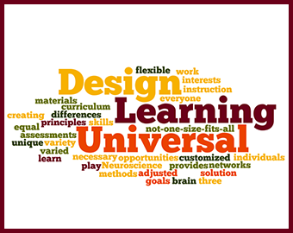
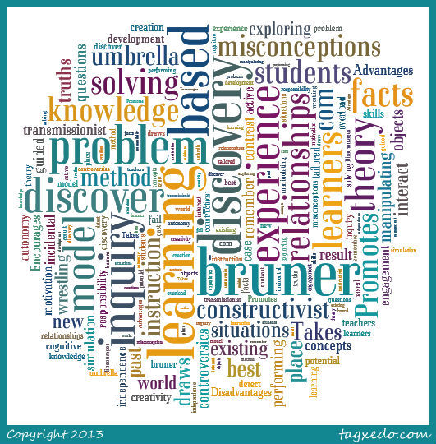
Compare and contrast
UDL vs. Bruner's Discovery Learning Model
*UDL is a set of principles used for curriculum development while Discovery Learning is a method of Inquiry Based Instruction.
VS.

Slide 7
Compare and contrast
*UDL consists of 3 principles (1) :
*Discovery learning integrates 5 principles (9) :
Provided multiple means of Representation
Provide multiple means of Action and Expression
Provide multiple means of Engagement
Problem Solving
Learner Management
Integrating and Connecting
Information Analysis and Interpretation
Failure and Feedback

Slide 8
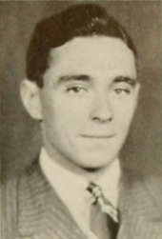
Compare and contrast
Universal Design for Learning's goal is to "give all individuals equal opportunity to learn."(1)
Bruner's Discovery Learning Model's goal is for "the learners to reach the end result on their own." (9)
Both UDL and the Discovery Learning Model can be used in conjunction with other theories.
Multiple techniques, such as games and stories, are used with both models to keep students interested in the topic.
The Discovery Learning Model and UDL encourage active involvement and creativity.
Bruner
Discovery Learning Model

Slide 9

Universal Design for learning
Goal: The students will apply mathematical process standards to represent and compare whole numbers, using the “ is greater” than and “is less” than symbols. The student is expected to recognize instantly the quantity of structured arrangements.

Slide 10

Differentiated Instruction
Have your room arranged so that workstations can be quickly set up or rearranged.
Provide a variety of materials neatly arranged and organized for student projects. These may include computers with Internet access, reference books, manipulative, construction and drawing materials, and audio/visual materials.
Think about the complexity of tasks and the thinking skills involved. Adjust your lesson plans to encourage thinking at various levels. Refer to Bloom's Taxonomy to view a continuum of thinking skills.
Offer several projects from which students can choose that cover the objective(s) on which you will be focusing. Have the choices reflect various learning styles. For example, visual learners may want the option to present what they have learned in a poster or brochure.

Slide 11

Differentiated Instruction: Teaching Strategies
Have partners choose nine different objects and draw each object on an index card.
Have children place the Numeral Cards and the object cards they made facedown in the two stacks.
Have each child choose a card from each stack, and use them to write an addition story using the number and item. For example: I have 10 blue crayons and 4 red crayons. I have 14 crayons. Which color crayon has the greatest

Slide 12
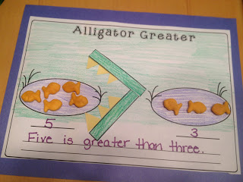
Activities:
Center #1
What you need:
Alligator Worksheet
Gold Fish
Glue
Scissors
Crayons/Markers
Students will make a “is greater” than problem with gold fish. Using glue the students will glue down the gold fish in the pond and then cut out the “is greater” than sign and teeth to complete the sentence and then write the problem in the space provided on the worksheet.

Slide 13
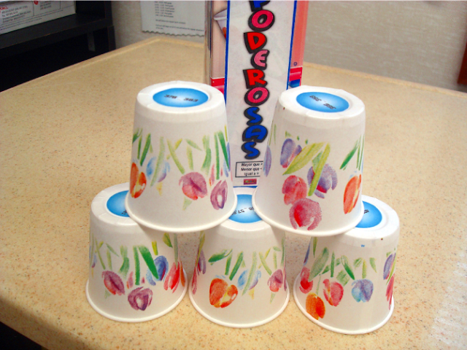
Note: Teacher must prep this game before hand. First, print out labels that will go on the bottom on the cup using the numbers you want your students to solve. Do not include the answer on the label, you can put the answer inside the bottom of the cup if needed .
Center #2
What you need:
Dixie Cups
Avery #5410 label
(you can write them
on the bottom of the
cup instead of using
label)
Instructions: Students will solve the problem on the bottom of the Dixie cup and stack the cups if they solve the problem correctly. If the students get it wrong, it goes back into the stack and the student get to try it again.

Slide 14
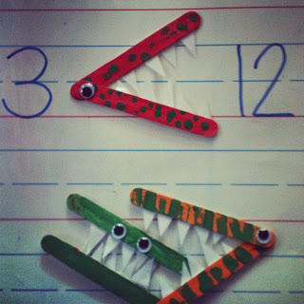
CENTER #3:
Math Monsters
What you need:
Jumbo popsicle sticks
Paint
Small paint brushes
Glue
Googly eyes
White construction paper
Playing cards
Manipulatives (connecting tubes, counters, etc)
Student can then use these to play games uses playing cards, connecting tubes, counters and any other manipulatives that you might have in the classroom.
Instruction: Paint the jumbo Popsicle sticks and glue the ends together. Place the “googly” eyes where the two popsicle sticks meet. Cut triangles out of the white construction paper and glue them on the edges between the two popsicle sticks.

Slide 15
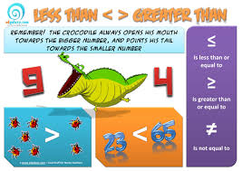
Center #4: SMART Board Game: Greater Than/Less Than
Students will play games on the smart board. Remember to remind your students to take turn.
http://www.abcya.com/comparing_number_values.htm
Students can chose easy, medium and hard.
http://www.education.com/game/less-than-greater-than/
http://www.learnalberta.ca/content/me3us/flash/lessonLauncher.html?lesson=lessons/05/m3_05_00_x.swf
This is a game will challenge those kids who needs a challenge.

Slide 16
References
What is Universal Design for Learning | National Center On Universal Design for Learning. (n.d.). Retrieved July 19, 2016, from http://www.udlcenter.org/aboutudl/whatisudl
The Three Principles | National Center On Universal Design for Learning. (n.d.). Retrieved July 19, 2016, from http://www.udlcenter.org/aboutudl/whatisudl/3principles
About Universal Design for Learning. (n.d.). Retrieved July 19, 2016, from http://www.cast.org/our-work/about-udl.html#.V47mCLgrJdg
Eagleton, M. (2015). Universal Design for Learning. Research Starters: Education (Online Edition),
Gatton, J. (2012, August 23). Retrieved from http://maisyflopsandollipops.blogspot.com/
Green, S. (2011, August 28). Retrieved from http://www.flapjackeducation.com/2011_08_01_archive.htm
Shaw, J. (2012, February 06). Retrieved from http://www.lessonplandiva.com/2012/02/freebies-ideas-and-science-activities.html
Jerome Bruner. nd. In Wikipedia.Retrieved July, 23, 2016, from http://en.wikipedia.org/wiki/Jerome_Butler (This is for the attached pic)
Passas, Christopher (2014). Instructional Design Models and Theories: The Discovery Learning Model. eLearning INDUSTRY. Retrieved July 19, 2016, from http://elearningindustry.com/discovery-learning-model

